Slide 1

McRank: Learning to Rank Using Multiple
Classification and Gradient Boosting
IE506 End-Term Presentation
Bishal Kumar Prabhat(213192001)
Vivek Seth(22M1521)
Instructor: Dr. P. Balamurugan
INDUSTRIAL ENGINEERING AND OPERATIONS RESEARCH
INDIAN INSTITUTE OF TECHNOLOGY BOMBAY
Powai, Mumbai-400076, India

Slide 2
CONTENTS
Objective & Motivation
Problem Statement
Work Done Before Mid Sem
Major Comments From The Mid Term Project Review.
Our take on Major Comments Received.
Work Done After Mid Term Project Review.
Summary and Comparison Of The Experiments.
Conclusion.
Possible Future Direction
References

Slide 3
MOTIVATION & OBJECTIVE:
The motivation behind the Mc Rank algorithm is to improve the effectiveness of ranking algorithms used in various applications, such as web search, recommendation systems, and information retrieval. In these applications, the goal is to provide users with a ranked list of relevant items based on their queries or preferences.
The Mc Rank algorithm is a machine learning method for learning to rank, which is the process of ordering a set of items based on their relevance to a query.
The authors have tried to cast the ranking problem as multiple classification (MC) and multiple ordinal classification problem.

Slide 4
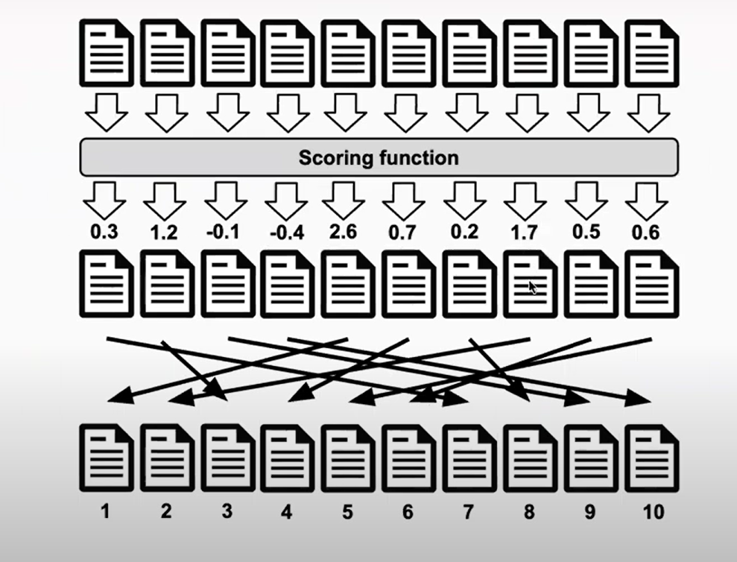
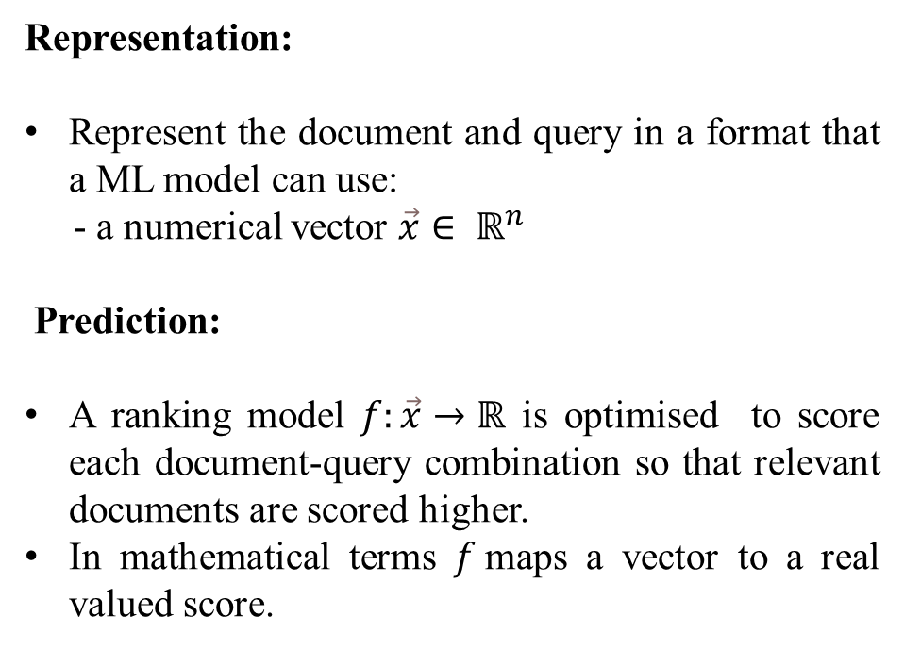
PROBLEM FORMULATION
Representation:
Represent the document and query in a format that a ML model can use:
- a numerical vector $\vec{x}∈ ℝ^{n}$
Prediction:
A ranking model $f:\vec{x}→ℝ$ is optimised to score each document-query combination so that relevant documents are scored higher.
In mathematical terms $f$maps a vector to a real valued score.

Slide 5
Work Done Before Mid Sem:
Studied the research paper and did a literature review on it.
Replicated the experiment on a small dataset
The data format for subset is shown as follows:
<label> <query-id>:<feature-value>... #docid = <feature-value>
0 qid:10002 1:0.007477 2:0.000000 3:1.000000 4:0.000000 5:0.007470 6:0.000000 7:0.000000 8:0.000000 9:0.000000 10:0.000000 11:0.471076 12:0.000000 13:1.000000 14:0.000000 15:0.477541 16:0.005120 17:0.000000 18:0.571429 19:0.000000 20:0.004806 21:0.768561 22:0.727734 23:0.716277 24:0.582061 25:0.000000 26:0.000000 27:0.000000 28:0.000000 29:0.780495 30:0.962382 31:0.999274 32:0.961524 33:0.000000 34:0.000000 35:0.000000 36:0.000000 37:0.797056 38:0.697327 39:0.721953 40:0.582568 41:0.000000 42:0.000000 43:0.000000 44:0.000000 45:0.000000 46:0.007042 #docid = GX008-86-4444840
We had a total of 46 features
The data set had 1384 rows × 57 columns

Slide 6
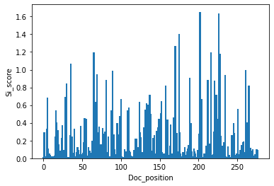
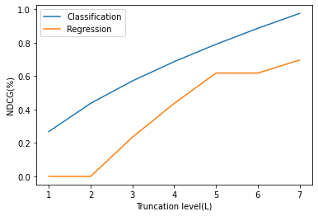
Continued….
The first one shows the plot between Si Score vs Document Position in the index.
The second one shows the plot between NDCG Score vs Truncation level
We also achieved the accuracy of 0.76

Slide 7
Major Comments From The Mid Term Project Review:
Apply the algorithm with the larger datasets and compare their results.
Apply algorithm like multiple ordinal, multiple classification and regression on available larger dataset.

Slide 8
Our Take on Major Comments Received.
We take a two dataset which is larger in comparison with the previous one-
1. 6000 rows × 138 columns
2. 10000 rows × 138 columns
We applied and compared the results obtained from following algorithms.
Multiple Ordinal Classification
Multiple Classification
Regression algorithm

Slide 9
AFTER MID-SEMESTER WORK

Slide 10
MSLR- WEB10K
The MSLR-WEB10K dataset consists of 10,000 and 6000 search queries over the documents from search results.
The datasets are machine learning data, in which queries and URLs are represented by IDs.
The datasets consist of feature vectors extracted from query-URL pairs along with relevance judgment labels.
The relevance judgments are obtained from a retired labelling set of a commercial web search engine (Microsoft Bing), which take 5 values from 0 (irrelevant) to 4 (perfectly relevant).
In the data files, each row corresponds to a query-URL pair.
0 qid:1 1:3 2:0 3:2 4:2 … 135:0 136:0
2 qid:1 1:3 2:3 3:0 4:0 … 135:0 136:0

Slide 11
DATA PREPROCESSING
Data Collection
Understanding of Data
Removing qid and docid
Removing colons from the features
Splitting the dataset into training and test datasets.

Slide 12
ALGORITHMS IMPLEMENTED

Slide 13
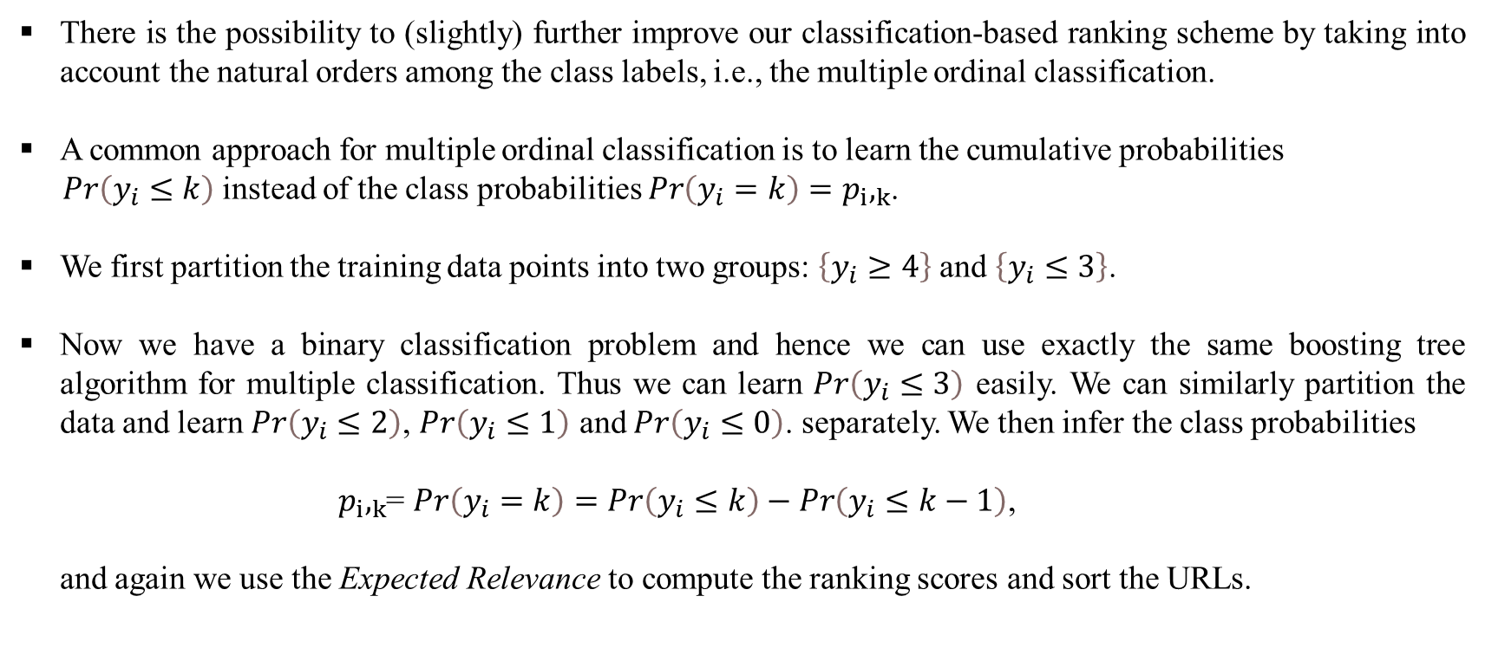
MULTIPLE ORDINAL CLASSIFICATION:
There is the possibility to (slightly) further improve our classification-based ranking scheme by taking into account the natural orders among the class labels, i.e., the multiple ordinal classification.
A common approach for multiple ordinal classification is to learn the cumulative probabilities
$Pr\left(y_{i}≤k\right)$instead of the class probabilities $Pr\left(y_{i}=k\right)=p_{i},_{k}$.
We first partition the training data points into two groups: $\left\{y_{i}≥4\right\}$ and $\left\{y_{i}≤3\right\}$.
Now we have a binary classification problem and hence we can use exactly the same boosting tree algorithm for multiple classification. Thus we can learn $Pr\left(y_{i}≤3\right)$ easily. We can similarly partition the data and learn $Pr\left(y_{i}≤2\right)$, $Pr\left(y_{i}≤1\right)$ and $Pr\left(y_{i}≤0\right)$. separately. We then infer the class probabilities
${ p}_{i},_{k}$= $Pr\left(y_{i}=k\right)=Pr\left(y_{i}≤k\right)−Pr\left(y_{i}≤k−1\right)$,
and again we use the Expected Relevance to compute the ranking scores and sort the URLs.

Slide 14
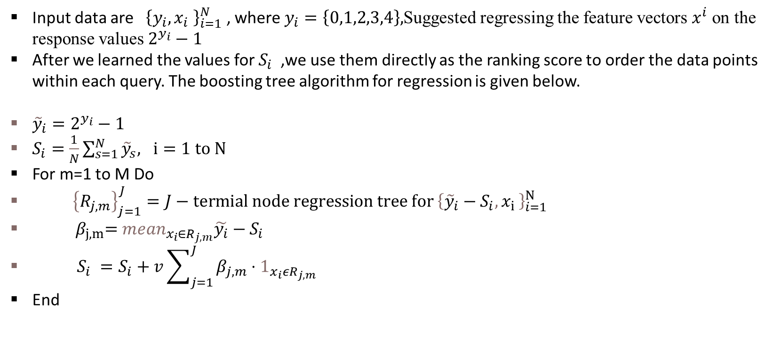
REGRESSION BASED RANKING USING GB
Input data are ${\left\{y_{i},x_{i} \right\}}_{i=1}^{N}$ , where $y_{i}=\left\{0,1,2,3,4\right\},$Suggested regressing the feature vectors $x^{i}$ on the response values $2^{y_{i}}−1$
After we learned the values for $S_{i}$ ,we use them directly as the ranking score to order the data points within each query. The boosting tree algorithm for regression is given below.
${\tilde{y}}_{i}=2^{y_{i}}−1$
$S_{i}=\frac{1}{N}\sum_{s=1}^{N}{{\tilde{y}}_{s}, ⅈ}=1 to N$
For m=1 to M Do
${\left\{R_{j,m}\right\}}_{j=1}^{J}=J−termial node regression tree for {\left\{{\tilde{y}}_{i}−S_{i}{, x}_{i}\right\}}_{i=1}^{N}$
${ β}_{j,m}={mean}_{x_{i}∈R_{j,m}}\tilde{y_{i}}−S_{i}$
$S_{i} =S_{i}+v\sum_{j=1}^{J}{β_{j,m}}⋅1_{x_{i}εR_{j,m}}$
End

Slide 15
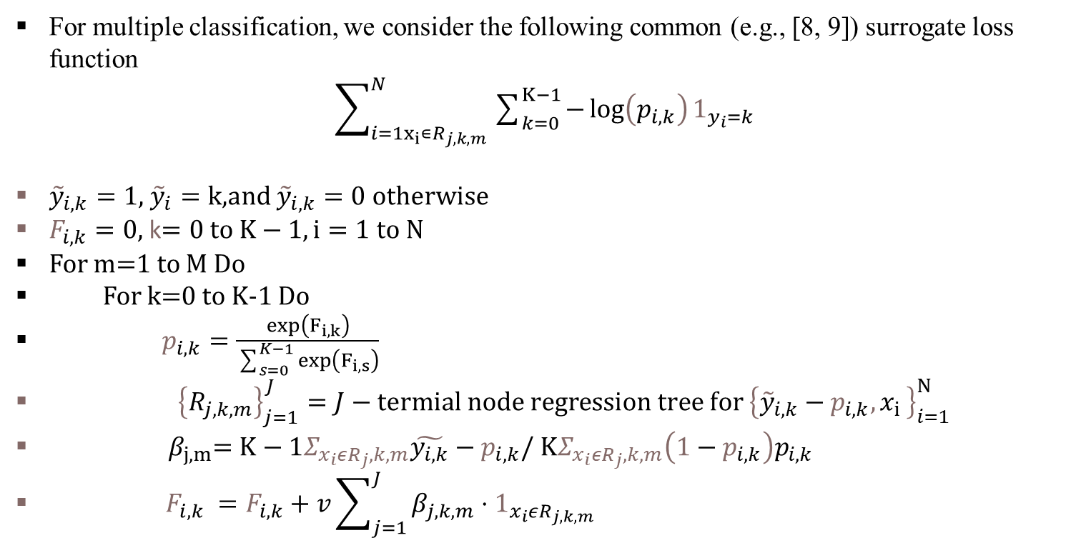
Algorithm for Learning Class Probabilities
For multiple classification, we consider the following common (e.g., [8, 9]) surrogate loss function
$\sum_{i=1x_{i}∊R_{j,k,m}}^{N}{\sum_{k=0}^{K−1}{−\log\left(p_{i,k}\right)}}1_{y_{i}=k}$
${\tilde{y}}_{i,k}=1$, ${\tilde{y}}_{i}=k$,and ${\tilde{y}}_{i,k}=0$ otherwise
$F_{i,k}=0$, k$=0 to K−1,i=1 to N$
For m=1 to M Do
For k=0 to K-1 Do
$p_{i,k}=\frac{exp\left(F_{i,k}\right)}{\sum_{s=0}^{K−1}{\exp\left(F_{i,s}\right)}}$
${\left\{R_{j,k,m}\right\}}_{j=1}^{J}=J−termial node regression tree for {\left\{{\tilde{y}}_{i,k}−p_{i,k}{, x}_{i}\right\}}_{i=1}^{N}$
${ β}_{j,m}=K−1Σ_{x_{i}εR_{j},k,m}\tilde{y_{i,k}}−p_{i,k}/$ $KΣ_{x_{i}εR_{j},k,m}\left(1−p_{i,k}\right)p_{i,k}$
$F_{i,k} =F_{i,k}+v\sum_{j=1}^{J}{β_{j,k,m}}⋅1_{x_{i}εR_{j,k,m}}$

Slide 16
COMPARISON OF RESULTS
Table1: Results from different algorithms @10 truncate values for web10k and web 6k datasets.
DATASETS | ORDINAL | CLASSIFICATION | REGRESSION
MSLR WEB-10K | 90.2 | 71.2 | 51.3
MSLR WEB-6K | 71.47 | 47.3 | 35.34

Slide 17
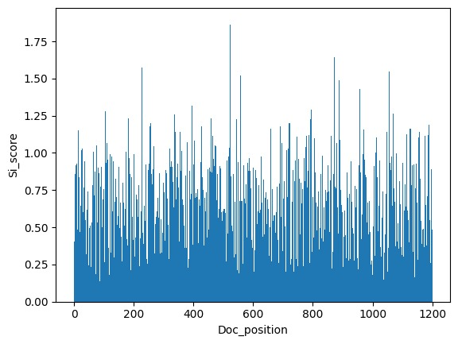
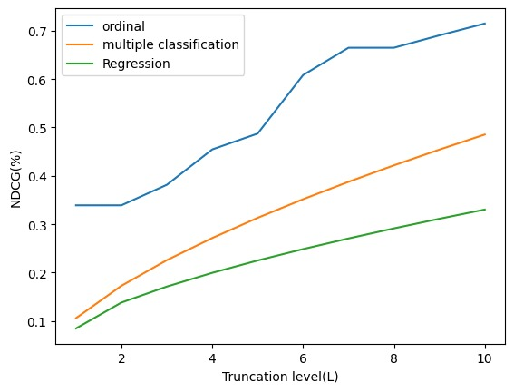
RESULTS
FOR MSLR WEB-6K DATASET:

Slide 18
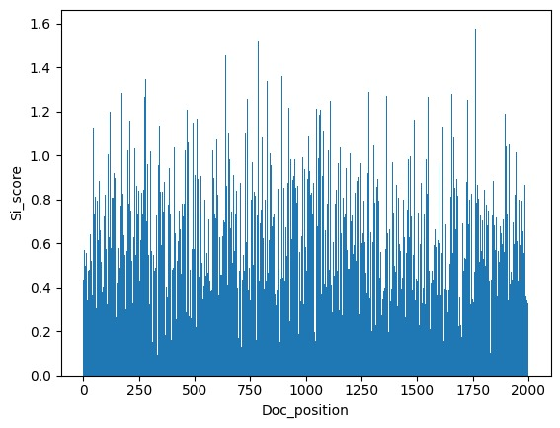
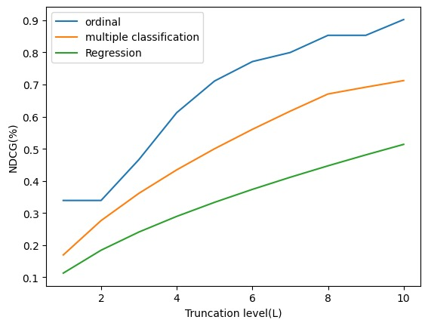
FOR MSLR-WEB10K DATASET:

Slide 19
CONCLUSION
From the experiment, we can see ordinal classification performs better than multiple classification as well as regression method.
At truncate value of 10, ordinal classification has ndcg score of 90.2 for web 10k and 71.2 for web 6k datasets.
This shows ranking problems can give better results with classification methods than regression based methods.
Overall the performance for the algorithms improves with larger datasets.

Slide 20
FUTURE SCOPE
Mc Rank algorithms could be compared with other ranking algorithms based on neural nets like RANKNET, RANKSVM or some recent learning to rank algorithms.
Mc Rank could be applied to several other domains apart from web search engines.
Make McRank more interpretable.

Slide 21
REFERENCES:
[1] C. Burges, T. Shaked, E. Renshaw, A. Lazier, M. Deeds, N. Hamilton, and G. Hullender. Learning to rank using gradient descent. In ICML, pages 89–96, 2005.
[2] J. Friedman, T. Hastie, and R. Tibshirani . Additive logistic regression: a statistical view of boosting. The Annals of Statistics, 28(2):337– 407, 2000.

Slide 22
Thank You…

